Slide 1
Smart Delivery Route
API Developer Role
- Tejas Thakor

Slide 2
My Role as API Developer
Technical Responsibilities:-
Design and maintain RESTful endpoints for telemetry, routing, prediction, and alerts
Integrate external APIs (traffic, weather, events) into backend services
Implement secure authentication using JWT and OAuth2
Optimize API performance for low-latency route computation

Slide 3
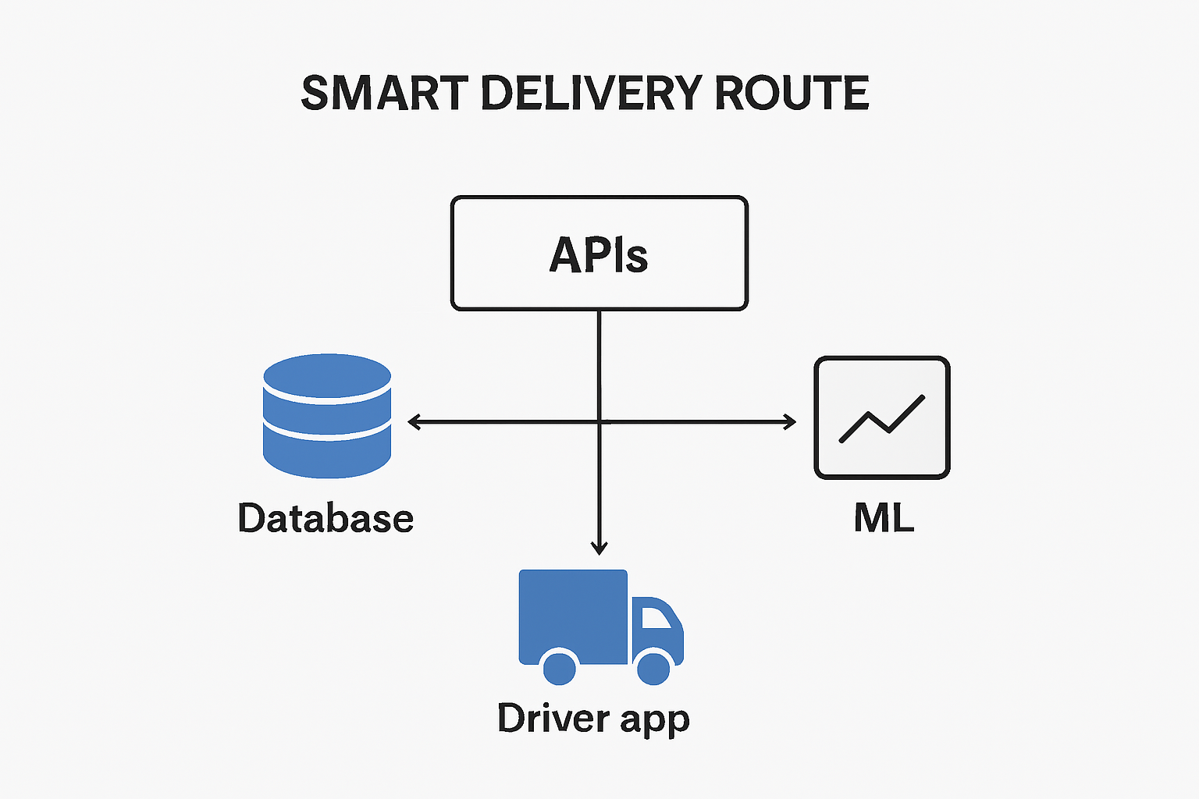
Architecture Overview
Content:
Data ingestion → Prediction → Routing → Driver App
APIs as the central hub
Diagram:APIs connecting DB, ML, and App

Slide 4
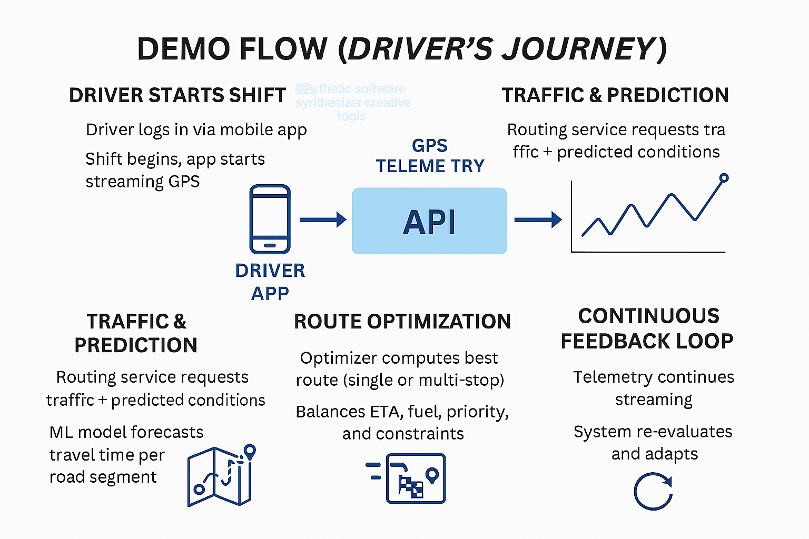
Example
Driver logs in →GPS streams → API ingests → ML predicts → Route optimized →App displays Route

Slide 5
Impact and Conclusion
APIs enable automation and reduce manual dispatching
Telementry helps us adapt routes dynamically
KPIs are:
On-time Delivery Rate
Efficient Fuel Consumption
Alert Triggered
Model Accuracy

Slide 6
Thank You

